Slide 1
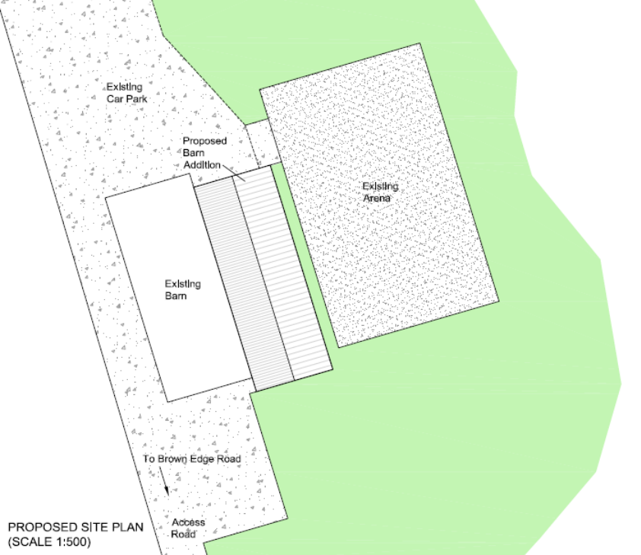
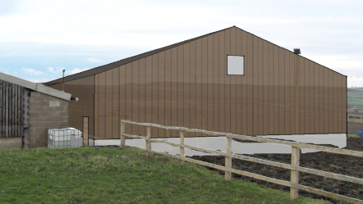
Design & Access Statement and Additional Information
Land at Brown Edge Road, Ingbirchworth
March 2013

Slide 2
Contents
1.0 Introduction
2.0 The Application Site
3.0 The Proposed Development
4.0 CABE Considerations

Slide 3
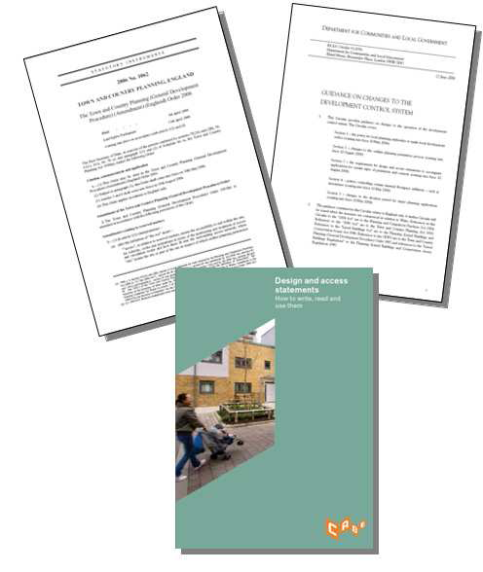
1.0 Introduction
This Design and Access Statement is submitted to support a full application for the erection of a barn unit, change of use of the existing building, land and ménage for the purposes of horse stabling, grazing, riding and the breeding and training of horses and removal of condition 3 of application number 2008/0736 at Land off Brown Edge Road, Ingbirchworth. The submission is made as part of the adopted requirements under the provisions of the Planning and Compulsory Purchase Act 2001 and advice set out in DCLG Circular 01/2006. It meets the requirements of ‘The Town and Country Planning (Development Management Procedure) (England) Order 2010’ and the guidance provided in ‘Design and Access Statements How to Write, Read and Use Them’ CABE 2006.
The application is supported by the following:
•Full plans and details
•Design and Access Statement

Slide 4
2.0 The Application Site
The application seeks consent for the erection of a barn, change of use of the existing building, land and ménage for the purposes of horse stabling, grazing, riding and the breeding and training of horses and removal of condition 3 of application number 2008/0736 at Land off Browns Edge Road, Ingbirchworth. Consent has been previously approved at this site, for the erection of a barn unit in connection with the equestrian use. (Application reference number: 2009/1396 – Approved with conditions on 22-02-2010)
This application is effectively for the relocation of the barn, to a location nearer to the existing barn and infrastructure onsite.
Proposed Barn

Slide 5
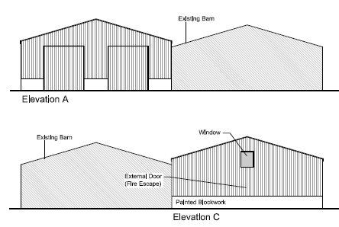
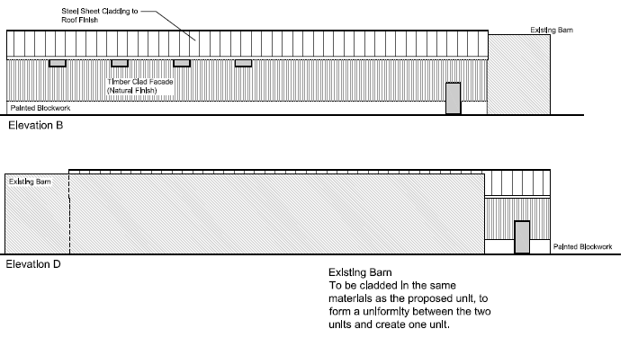
3.0 The Proposed Development
The proposed development includes the erection of a barn unit for uses such as storage of hay and tack in keeping with the current land use. The change of use of the existing building, land and ménage for the purposes of horse stabling, grazing, riding and the breeding and training of horses and removal of condition 3 of application number 2008/0736.
Proposed Elevations of barn unit

Slide 6
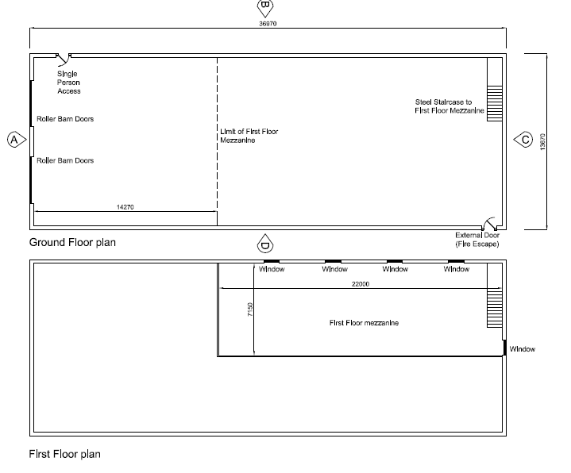
The proposed barn unit will be used for storage of hay, tack and other equipment in connection with the proposed use and will contain a mezzanine floor to increase storage provision.
Proposed Barn Unit Floor Plans

Slide 7
A state-of-the-art stud farm/breeding programme business operates with respect to the level of facilities that are required, and the day-to-day activities that would take place. The applicant seeks to breed, train and maintain the best possible mares and foals to achieve sporting excellence and at present they possess 11 horses of this quality, which are currently being kept at the applicants existing premises. The applicant’s daughter, has represented Great Britain twice at European Championship level and is looking to develop a business which will provide the opportunity to breed and maintain horses of this caliber for the future. The applicant states that if these high standards are to be maintained then similarly high standards of training, breeding and stabling facilities need to be provided within a single site. For example, It is important that mares and foals are located on site with all necessary facilities to ensure their future training is of the highest quality. Additionally there is an expectation with a business which deals with horses of this caliber that the facilities provided will be on a single site and of the highest standard.
It is the applicant’s intention to provide financial stability to the breeding programme through the provision of a state of the art livery service, similar to the current use on the site. It is expected that there will be approximately 11 competing horses, 8 livery horses and around 10 mares and foals using the site at any one time. Initially there will no stallions kept on the site, as mares will be artificially inseminated.
Vehicular movements on the site at present are approximately 17 cars to and from the site twice daily. The applicant anticipates that the proposed application will see a reduction in vehicular movements, with approximately 15 vehicular movements twice daily.

Slide 8
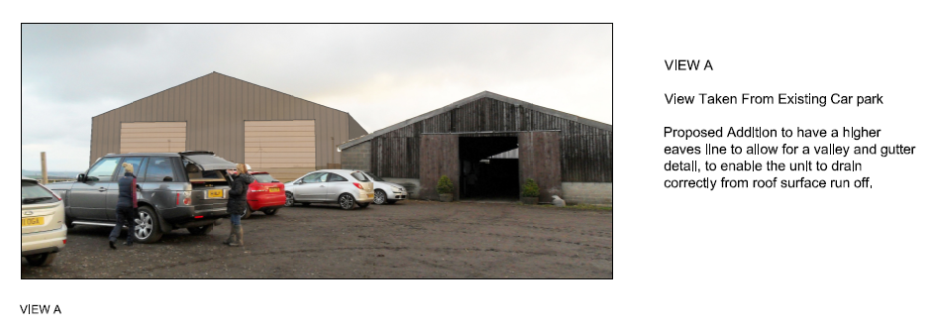
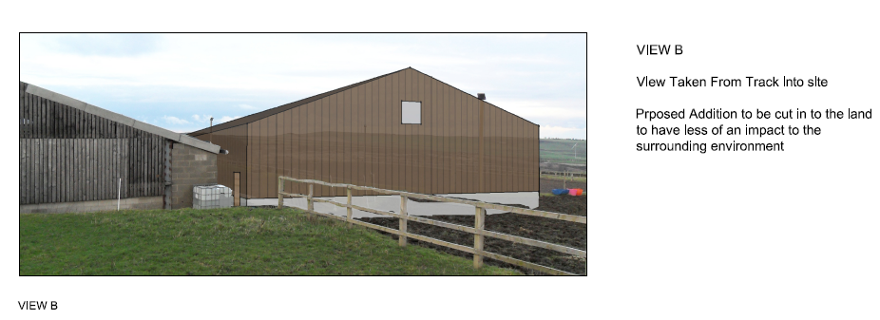
Indicative Views

Slide 9
4.0 CABE Considerations
Use
The principle of development is established by way of the previously approved barn unit – which has never been developed. The use of the site, for equestrian purposes, is compatible with the existing and surrounding land uses. The proposed location is well thought out in relation to the existing infrastructure on the site and is ideally located to facilitate management and everyday uses.
Amount
The application seeks consent for a barn unit, which is in keeping with the existing infrastructure and designed to suit the uses it is intended for and the change of use across the site.
Appearance
The appearance of the proposed barn unit has been carefully considered to reflect the character and appearance of the locality. The materials used will be the same as the existing barn unit, to create a uniformity between the existing and proposed. The change of use and removal of condition will present no change in appearance.

Slide 10
CABE Considerations continued…
Access
Safe, level and well lit access it provided for vehicles and pedestrians along the existing site access off Brown Edge Road.
Scale
The overall scale and massing respects the predominant nature and character of the previously approved barn unit and the existing barn unit on site.
The proposed barn unit, is not considered to be overbearing or have a detrimental impact on the surrounding area and countryside. The scale of the proposed breeding and keeping of horses is in keeping with the existing circumstances.
Landscaping
The site at present is in use as a livery yard. Landscaping will be implemented to enhance the visual impact of the barn unit and provide screening and character .

