Slide 1
Cawthorne STW WINEP
Traffic Management Plan

Slide 2
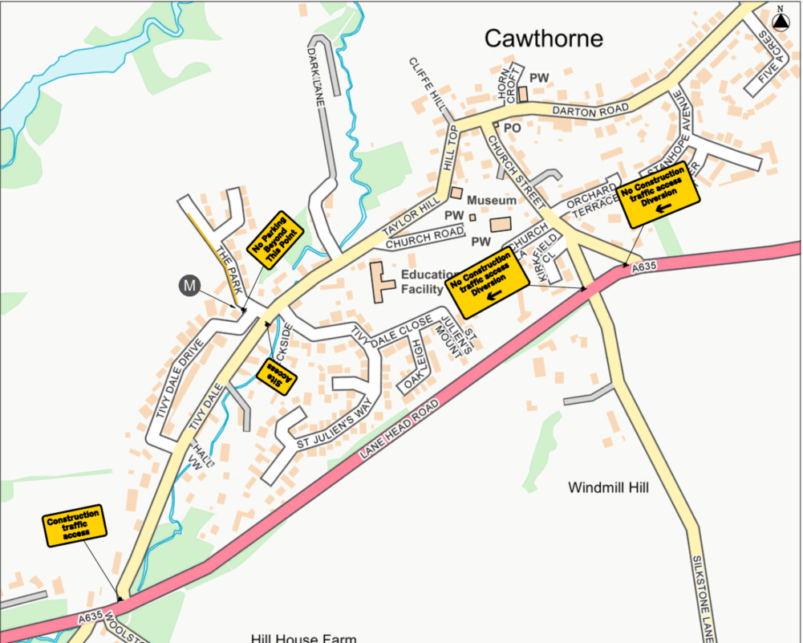
Cawthorne Village TM

Slide 3
Parking Restriction Details
Road to be Implemented: The Park
Address: The Park, Cawthorne, Barnsley S75 4EL
Details: Starting at the bottom of ‘The Park’, from the ‘Tivy Dale’ entrance on to ‘The Park’, just after the entrance to ‘Tivy Dale Drive’ on the South West of ‘The Park’ to allow access onto ‘Tivy Dale Drive’ and all throughout ‘The Park’. ‘The Park’ is then a dead end for vehicular traffic (not including the access to site we are constructing).
Deliveries: No deliveries through the village.
Restriction dates: Monday 17th July 2023 – 12th April 2024
Please Note: Working Hours will be 07:30 – 17:00
Noisy works will not commence until 08:00

Slide 4
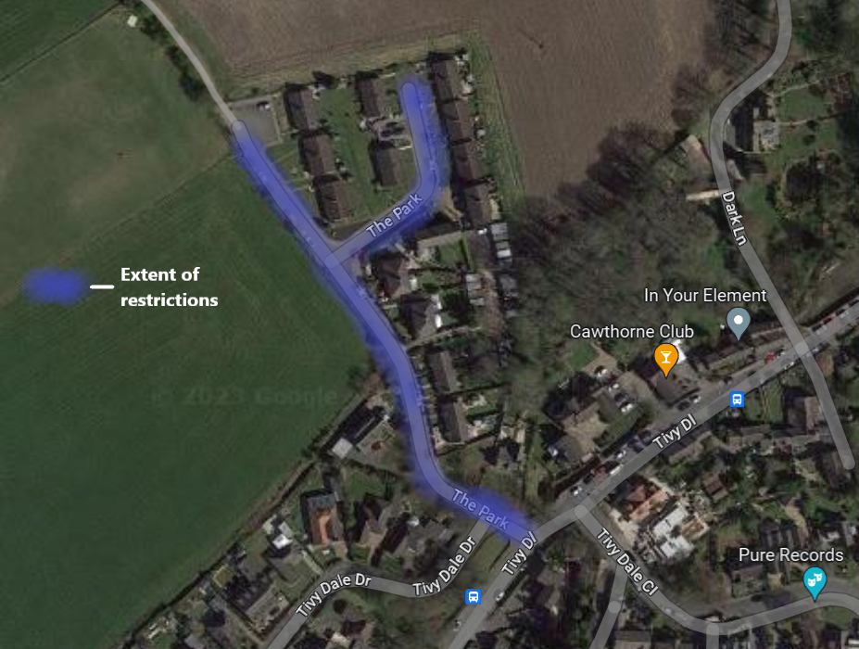
Extent of Restrictions

Slide 5
Extent of Restrictions
Plan: Allow unrestricted access onto ‘Tivy Dale Drive’, restricting access only to parking on ‘The Park’.
Restrictions will apply for all members of the public, inclusive of workers of the ‘Yorkshire Water Waste Water Treatment Works’ Development.
Restrictions will not apply for residents of ‘The Park’, this will be manned during working hours throughout our busy periods for safety and access.
Access will be permitted to park via permits, or dash visible documentation
Permits will be issued to residents & their regular visitors and carers
Permits will not be required for emergency services, taxis or delivery / collection vehicles.

Slide 6
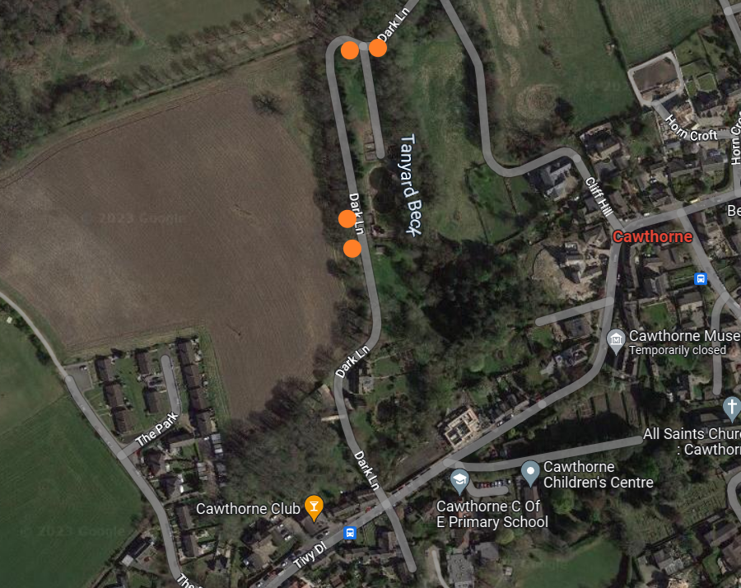

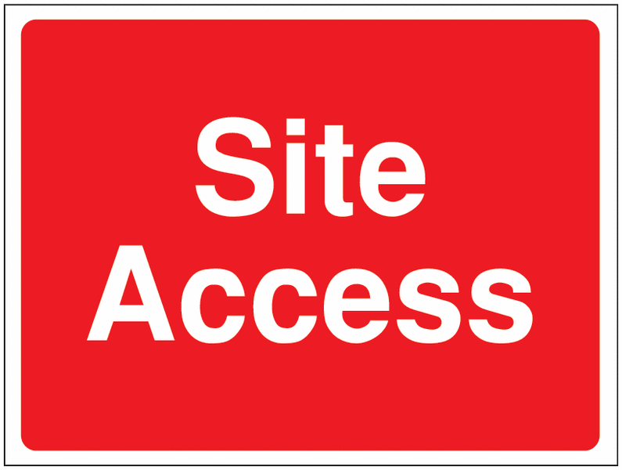


Dark Lane TM

Slide 7
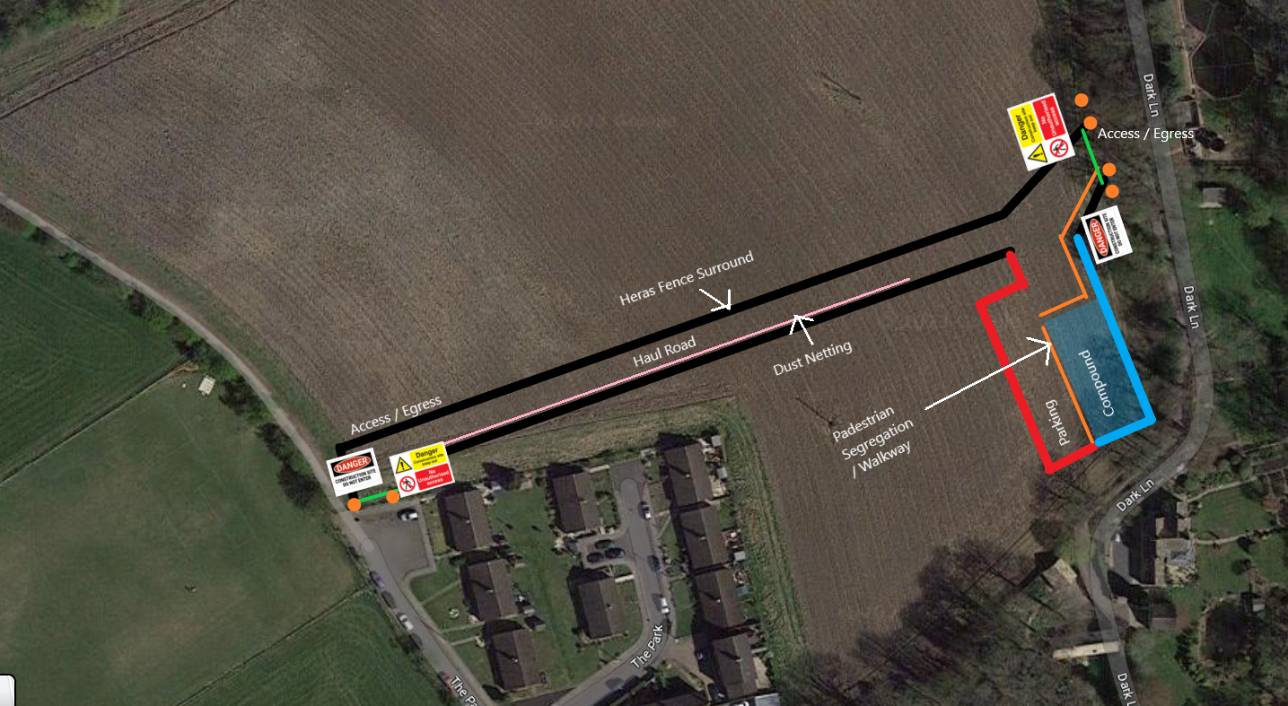
Haul Road & Compound Set Up
Topsoil arising's to be stockpiled here.

Slide 8
Haul Road & Compound Set Up
All Site staff, operatives and visitors will utilise the ‘Parking Area’ within the confines of the haul road and compound as designated within the previous slide.
All site traffic will enter the haul road via the access on ‘The Park’, exiting the haul road onto ‘Dark Lane’, to access the treatment works. To exit the works, this route shall be reversed.
A traffic Marshal will be present where deemed necessary, during busy periods.
All loading and unloading of plant, materials and equipment will be done so safely, within the confines of the haul road and compound or within the treatment works.
There will be very little requirement for the storage of plant and materials for this development. Where required, designated areas will be provided within the confines of the haul road or the treatment works.
The nature of the haul road should prevent excess mud and dirt finding it’s way on to the highway, in the event this occurs, a road sweeper will be implemented.
The road construction will consist of:
  200mm reduce dig (stockpiled on site as per slide 7)
  Non woven geotextile Teram
  100mm 6F5 aggregate
  Biaxial Tensar
  100mm 6F5 aggregate
  100mm Type 1 aggregate
Topsoil arising's to be stockpiled here.

Slide 9
Haul Road & Compound Set Up
The fencing used as a perimeter to the haul road and compound is standard Heras fencing.
Each fencing panel is 3.5m in length and 2.0m in height.
The fencing is utilised to separate the public from the works and vehicle / plant movements, keeping everyone safe.
There is approximately 550m of fencing keeping the public safe.
Approximately 150m of this fencing is to be covered in debris netting, helping to catch any residual dust, to keep the residents on ‘The Park’ safe from dust exposure. 50m of this dust fencing does not form part of the perimeter, but is erected solely for the purpose of dust capture.
Within the confines of the Heras is post and rope segregation, outlining the scope of the road and allowing space between road and fencing to prevent collisions.
The fencing is to be accompanied by safety and construction warning signs along its length.
The haul road will incorporate a simple drainage structure to prevent failure and movement, by way of French drains.
All haul road elements are to be removed upon completion of the works, inclusive of drains and stone.
Topsoil arising's to be stockpiled here.

Slide 10
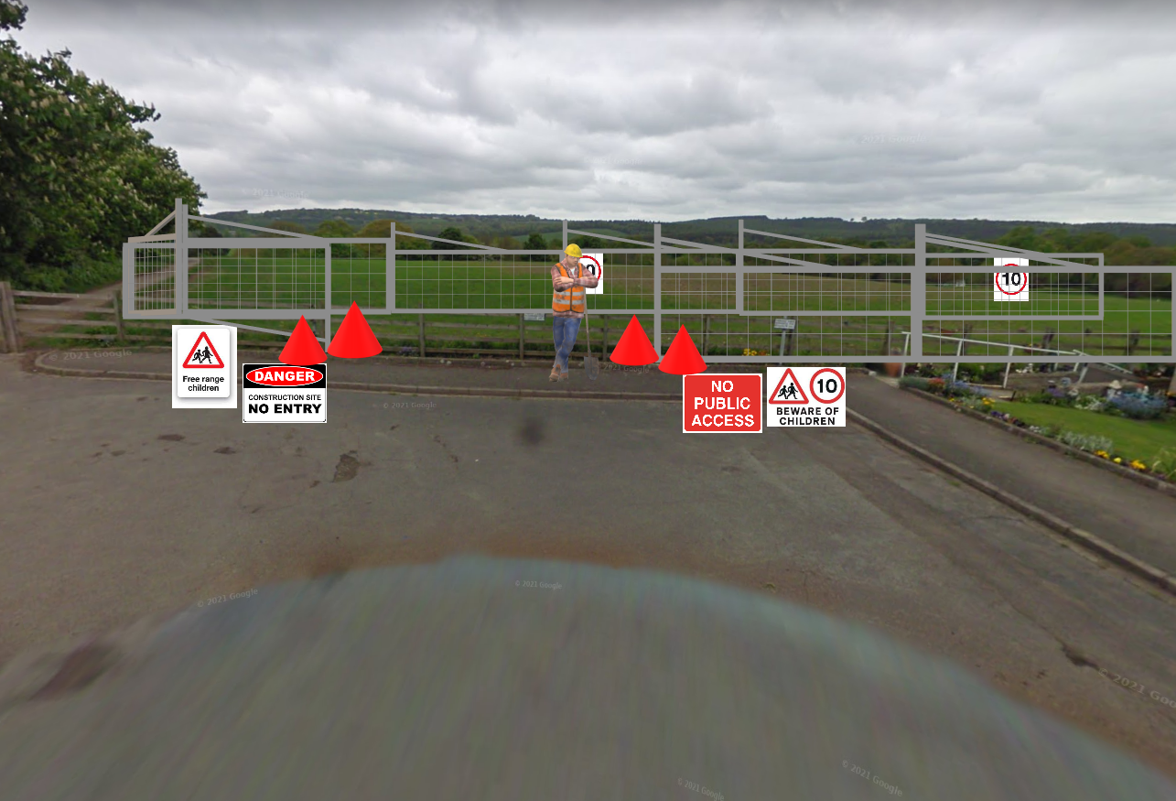

The Park TM North Detail

Slide 11
The Park TM North Detail
At the North of ‘The Park’, where construction traffic will access and egress to and from the haul road, clear signage and segregation from the public will be implemented.
Signs will include reduced speed limit of 5mph, warning of children in the area and construction warning signs.
During busy periods a traffic marshal will be present to increase safety in the area.
The haul road will have clear segregation from the public and away from the heavily trafficked footpath that runs adjacent to the West.

Slide 12
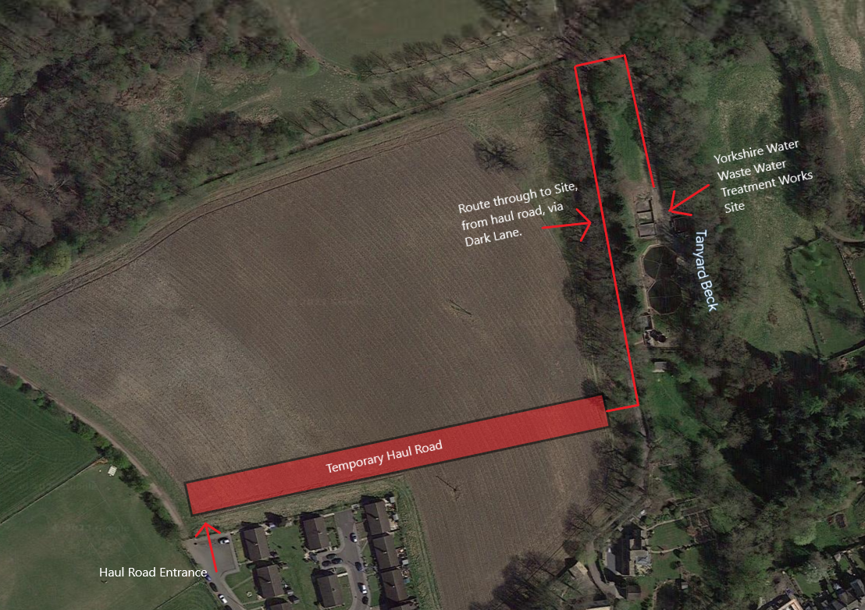



Site Access Route

Slide 13
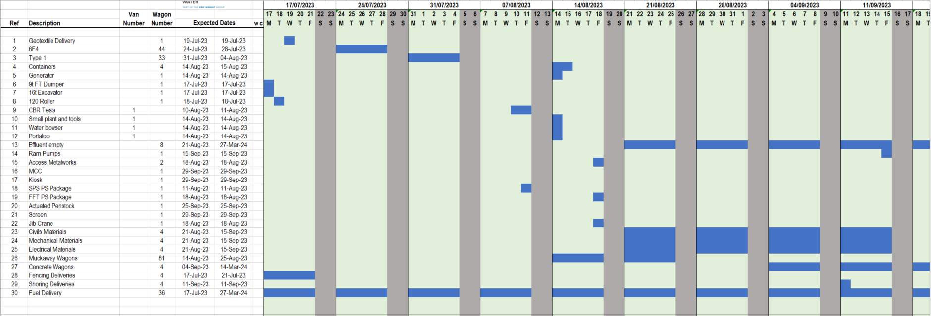
Vehicle Movements Estimate

Slide 14
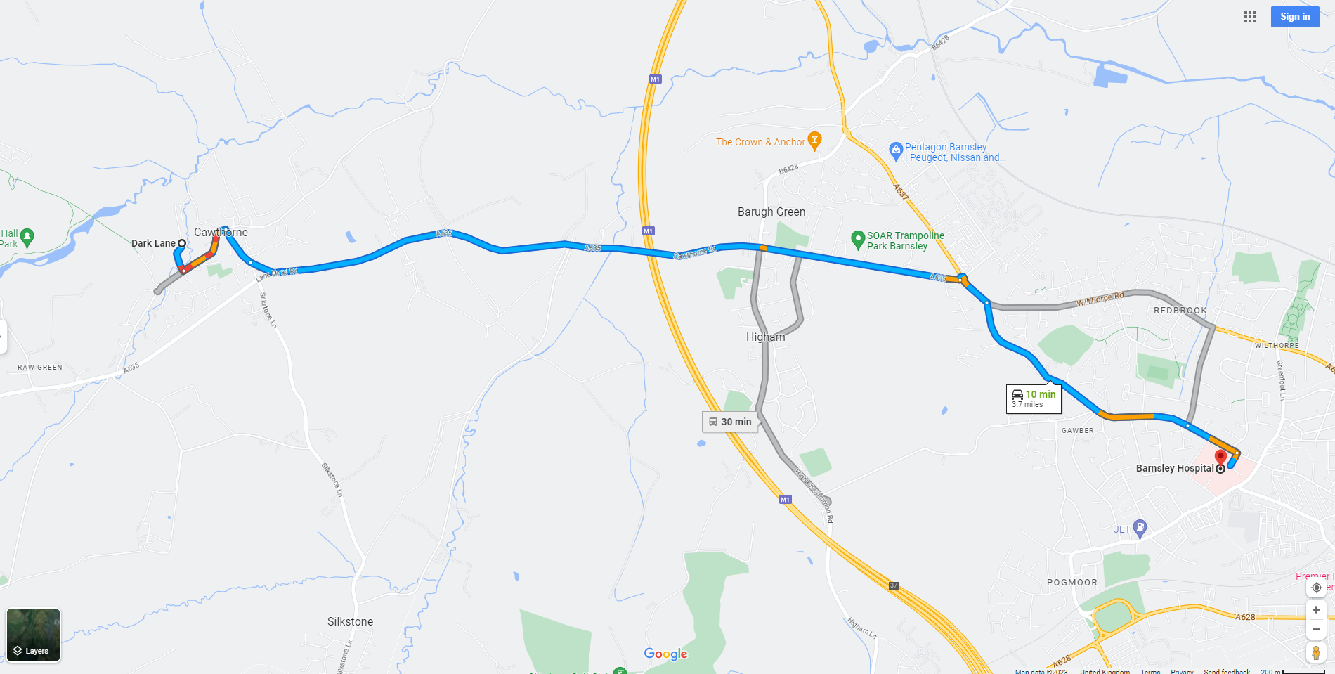
Nearest Hospital – Barnsley Hospital

Slide 15
Eric Wright Water Ltd
Project Manager:
Alex Lingwood
07583 006362
alingwood@ericwright.co.uk

