Slide 1
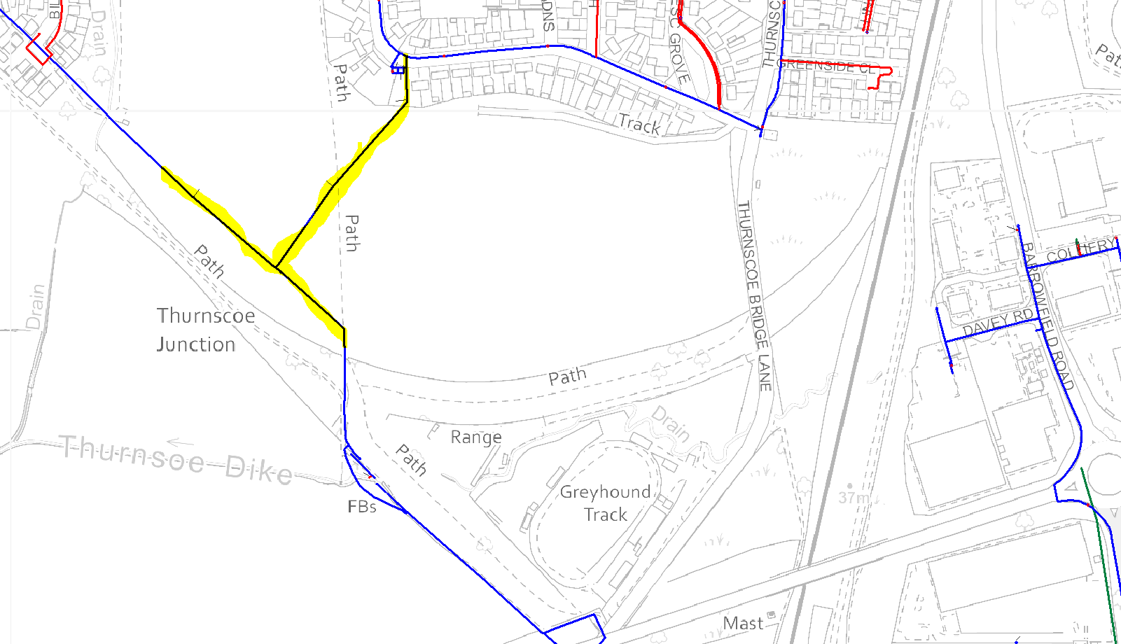
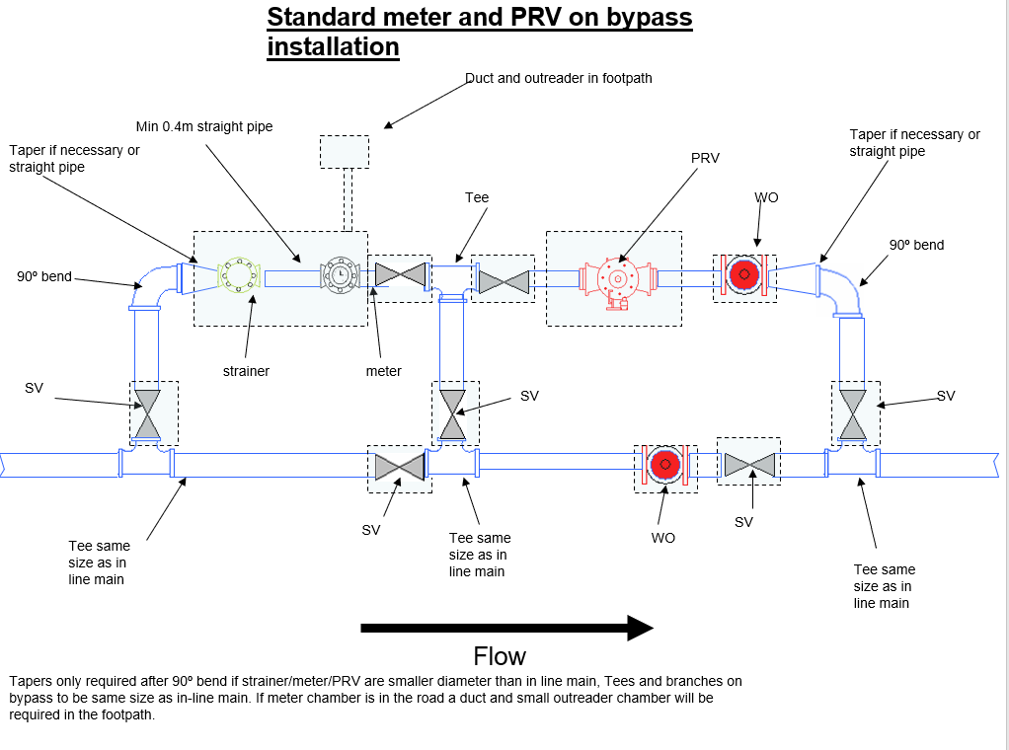
Odyssey layout - Diversions
2x
UPC and end W/ cap offs
Abadon 6” see detail A
Diverted 500metres of 180mm. With new DMA 100mm strainer meter and 160mm bypass arrangement (standard design)
UPC
UPC and end W/ cap offs
Abandon existing 9” and divert through site with 12metre easement including no tree panting etc..
180mm UPC connection from 8” UPVC. With Valve and washout

Slide 2
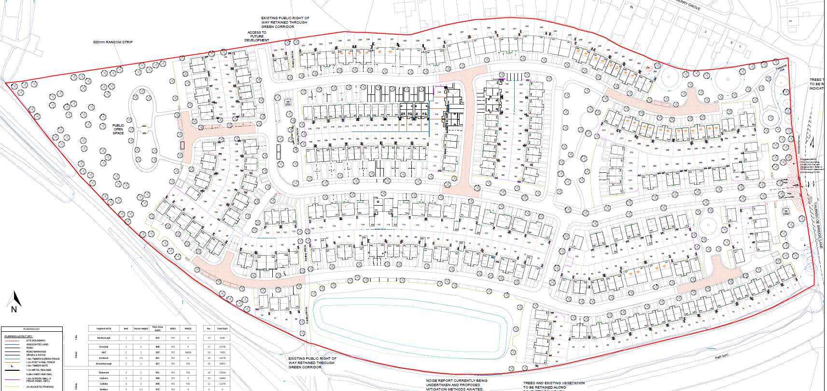
Site schematic - Diversions
2x
See detail A
X
X
See detail B
X
X
UPC and end W/ cap offs
X
X
X
X
X
X
X
X
X
X
X
X
X
Abandon existing 6” and
X
X
X
X
X
X
X
Abandon existing 9” and divert through site with 12 metre easement including no tree panting etc..
X
X
X
X
X
X
X
12metre easement required (maybe issues between attenuation pond and houses)
X
UPC and end W/ cap offs

Slide 3
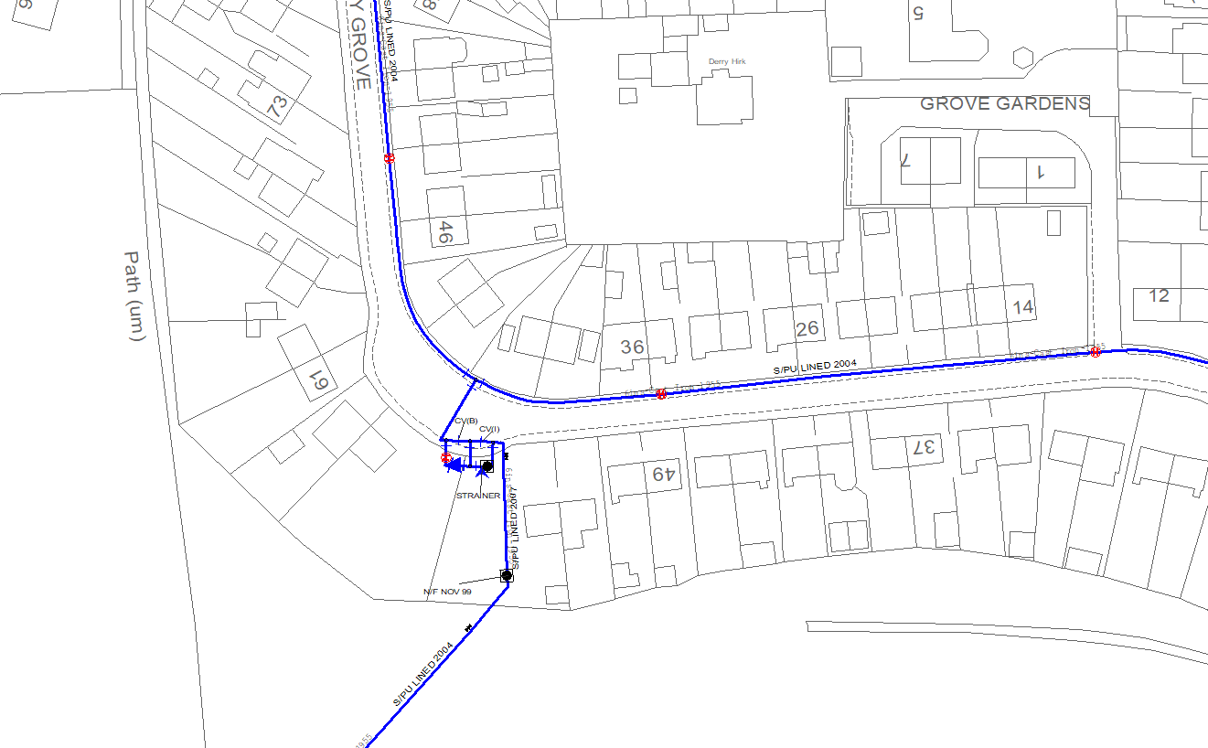
(detail) A
Fit washout and abandon 9” along with meter /PRV and strainer arrangement
X
X
X
X
X
X
X
X
X
X

Slide 4
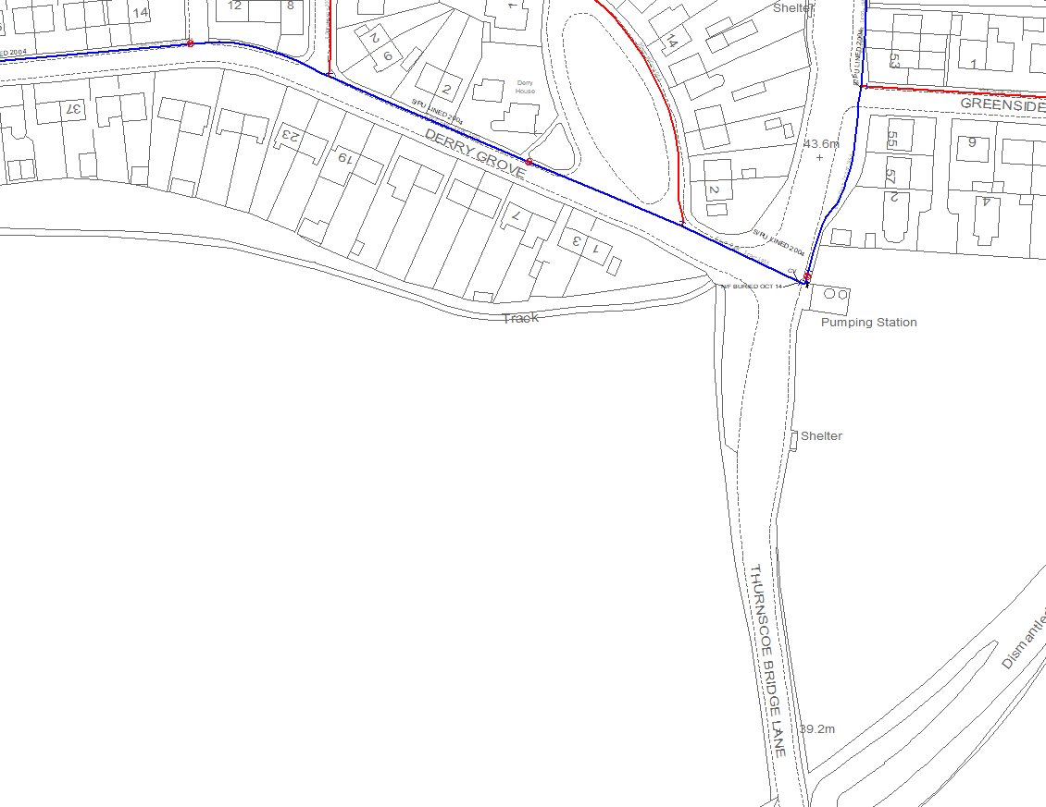
(detail) B
Diverted 6” with new DMA 100mm strainer meter and 160mm bypass arrangement (standard design)

