Slide 1
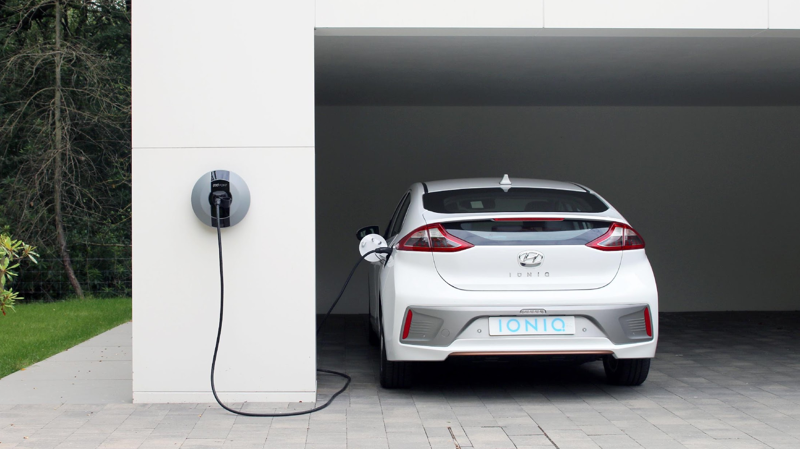

What is rapid charging?
Lidl requirements
Process & Pricing
Location
Power
Groundworks
M&E
Logistics
Click header to start

Slide 2
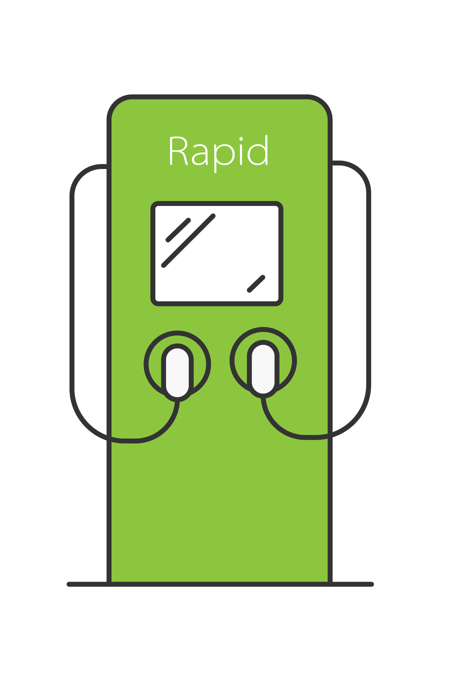





What is Rapid Charging?
DC input
AC 400V 63A 3-P
400V 125A 3-phase mains isolator
On board car charger
DC 500V 125A
(CHAdeMO/CCS)
To grid
DC input
Rapid Charger

Slide 3
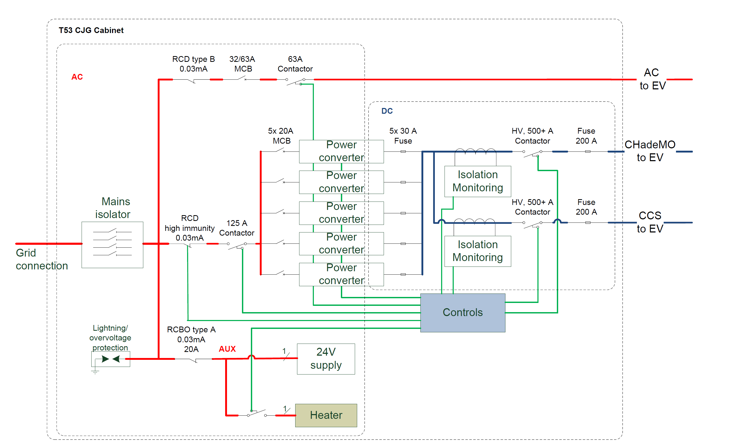

Slide 4
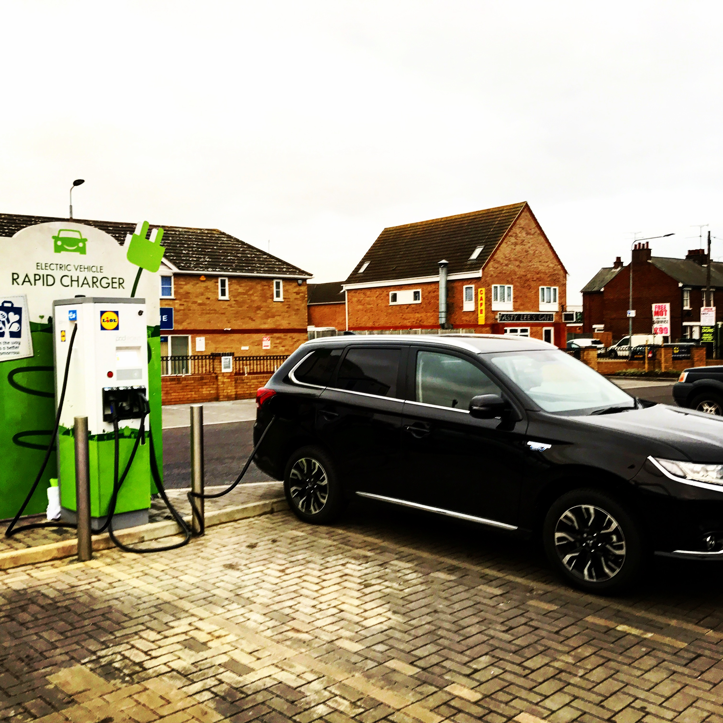
Requirements
1 x ‘Terra 53 CJG’ Rapid Charger supplied by ABB via POD Point wrapped with Lidl CSR visual
5m² double sided sign with Lidl CSR visuals
2nd & independently metered electricity connection from grid
Designated feeder pillar kiosk
Protective bollards
Earth pit
3 standard parking spaces = 2 EV spaces (as per Space Architects drawings
Charger installed, operated and maintained by POD Point. We are here to make it easy for you!

Slide 5
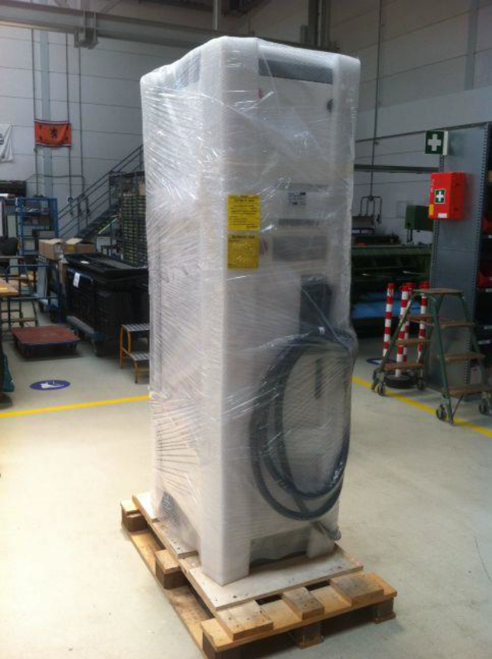
Process
Introduction
Sending of SCC pack with info and specs
Power application
Ordering of equipment (8 to 12 week lead times)
Receipt of site plans
Desktop survey
Installation scope agreed
Groundworks
Installation before PC1
Commissioning

Slide 6
Pricing
Product | Description | Cost
Tera 53CJG | Triple output rapid charger | £18,336
Delivery | Transport to UK warehouse NOT site | £415
ABB data fees | Annual fee for ABB rapid charger to communicate with POD Point MIS | £122/year
Double sided sign | Installed on site with Lidl CSR visuals | £1350
Rapid charger wrap | Wrapping of ABB rapid charger at factory | £240
Extended warranty | 1 year as standard, extension from years 2 to 3 Can only be offered with SLA & purchased upfront. | £1922
Commissioning | Remote support by an ABB. On site by ABB trained and certified person included. | £765
SLA | Remote support, software-updates and bug fixes by ABB help desk. Onsite support outside warranty at cost. | £1480/year
Project Management | Fee per store to cover the management of: timely installation of charge points and associated services in line with SOD deadline requirements; provision of separate power supply for chargers from DNO; metering services and processing electricity bills for duration of contract. | £2,000
Sub total |  | £26,630
Installation | Varies per site (excluding DNO costs) | £5k to £15k

Slide 7
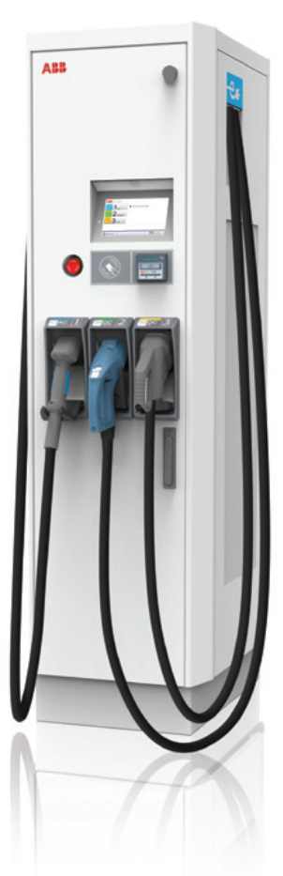
Your Solution
ABB Terra 53 CJG
World leading rapid charger
Three year warranty & maintenance
48 hour SLA
One site visit per year to replace filters & conduct tests/checks
Three years data & access to MIS
UK delivery
On-site commissioning
Fully installed
Independently metered
CSR visuals
All done by us with minimal input from you

Slide 8
Responsibilities
Item | Responsibility
Rapid charger supply & install | POD Point
Rapid charger wrapping with Lidl CSRF visual | POD Point
Rapid charger concrete base | Main Contractor
Rapid charger earthing pit | Main contractor
5m double sided sign supply | POD Point
5m double sided sign install | POD Point
5m double sided sign base | Main contractor
2nd & independently metered grid connection | SCC or POD Point
Designated feeder pillar (GRP) housing & base | Main contractor
Designated feeder pillar distribution board | Main contractor
Designated feeder pillar mains isolator switch | Main contractor
IMserv meter ordering & install | POD Point
Ducting from feeder pillar to charger | Main contractor
Cables from feeder pillar to charger | POD Point
Protective bollards supply & install | Main contractor

Slide 9
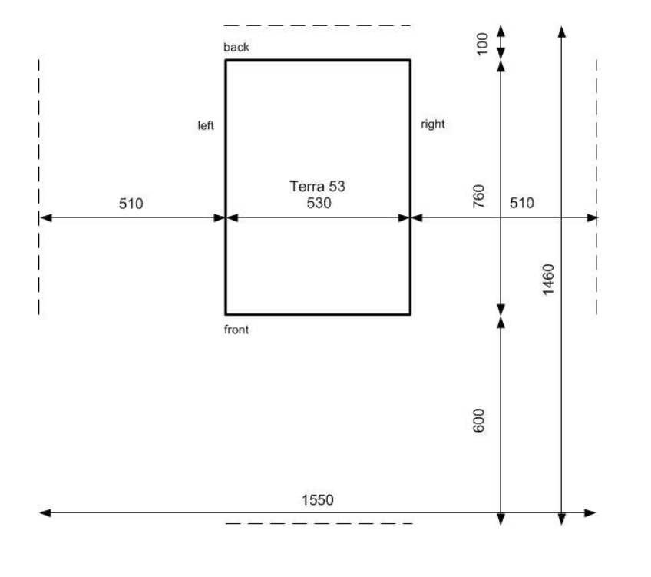
Location
Goldilocks Zone – locating EVC far enough from store entrance to reduce risk of ‘ICEing’ and creating bad customer experience & close enough to (potential) power supply for cost effective installation
EVC positioned near roadside for visibility (if possible)
Start conversation early in planning stage
The EVC requires a space of 1550 x 1460 mm.
- Size Charger W x D x H: 530 x 760 x 1900 mm.
- Front side 600 mm, in order to open the front door
- Left and right side 510 mm, to open left and right panel.
- Backside 100 mm, for unimpeded airflow
The EVC has an air inlet on the right side and outlet on the back
Please refer to EVC drawing from Space Architects
Technical drawings available on Conject
Need to respect these dims for maintenance, bollards & signage positioning

Slide 10
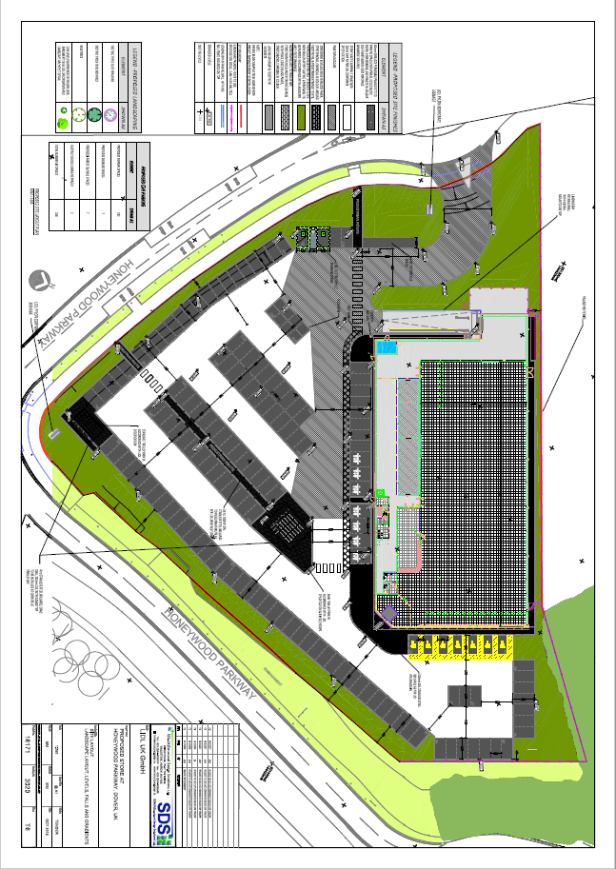
Ideal Layout
Energy Supply
Lidl Store Entrance
Electric Vehicle Charging Points

Slide 11
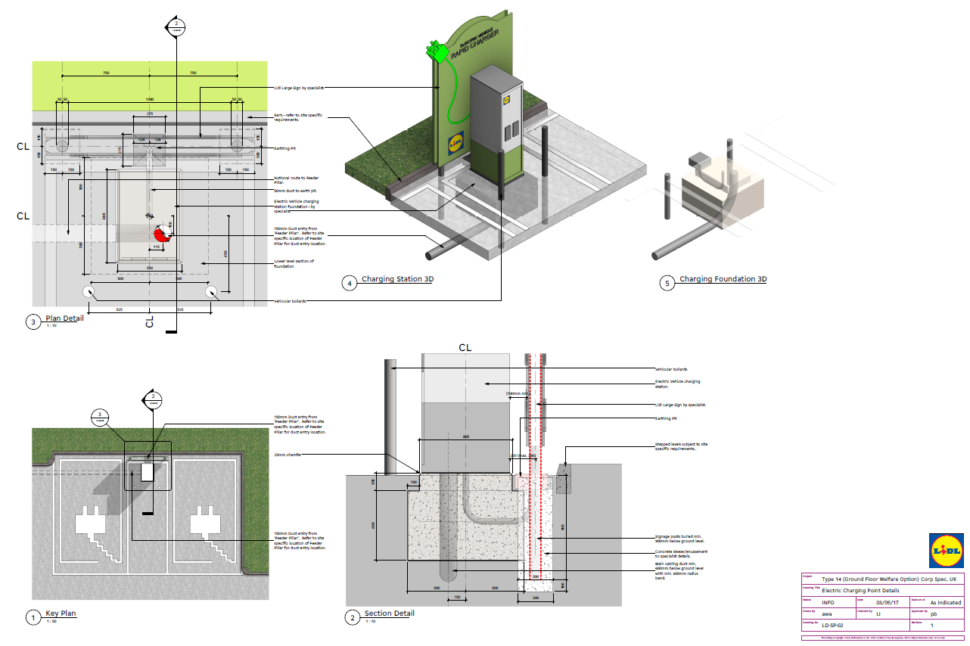
EVC Install Layout
N.B. drawing is for illustration purposes ONLY. Technical drawing PDF will be provided separately with this pack

Slide 12
Power
Electric Vehicle Charger (EVC) limited to 86kVa
Both AC & DC (either connector) can charge at same time
Lidl UK strategy: Requires 2nd independently metered grid connection (separate from store)
POD Point can arrange connections for car charger & store if required via Triconnex
Problematic to do both independently. Important to apply for both at same time and well in advance!
Early applications very important, can take up to 6 months
Costs circa £15 to 100k depending on grid locality
Legal process managed by Triconnex if we handle connections
We cannot complete the EVC requirements without power! (installation, testing, commissioning, metering!) multiple site visits are costly
This issue is causing problems at multiple sites when not co-ordinated/planned effectively

Slide 13
Groundworks
Main contractors responsibilities:
Concrete base for charger needs EXACT spec (poured on site)
Can be poured on site or purchased pre fabricated
Ducting from EVC to power & earth pit
Foundation for large sign
Feeder pillar base
Bollards supply & installation
No right angles! (Minimum 600mm radius on bend!)
150mm ducting required
Technical drawings available on Conject
DIMS are critical for dropping unit and threading cables
DNO requirements for ducting size & depth are statutory obligations and must be adhered to.

Slide 14
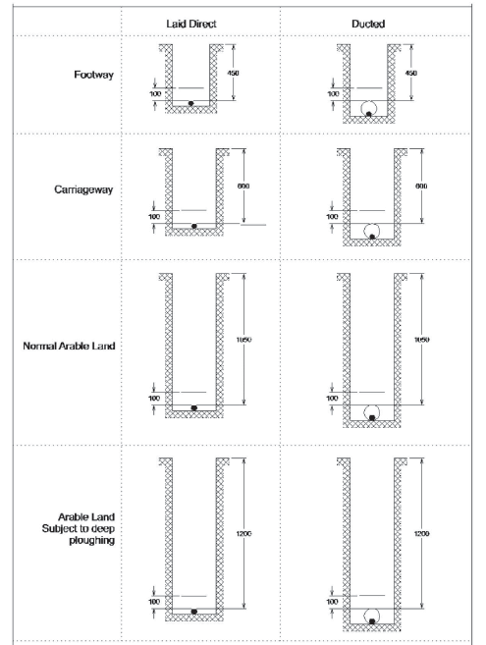
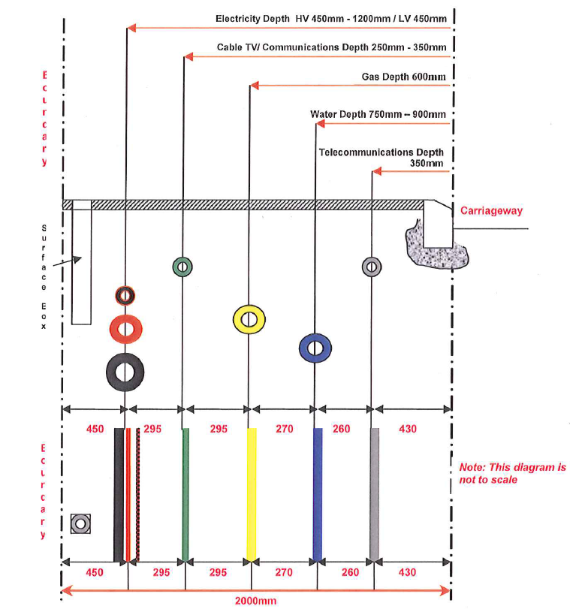
FAO MC: Installation of Underground Cables - LV to 132kV

Slide 15
M&E
POD Point will organise metering (Imserv) for EVC & store connection (if handling both)
Your M&E teams will need to install feeder pillar/kiosk with distribution board & main isolator rated at minimum160A with tails for supply connection (typically 50mm²) and adequate space for EVC circuit protection. Please confirm with POD Point for your store.
POD Point will run cables from EVC to connection
Standard earth pit needed 2.5m from EVC
Please refer to EVC drawings by Space Architects available on Conject
The EVC dist board does not have to be from W&K.

Slide 16
Logistics
WARNING
Heavy equipment - 350 kg.
Needs crane, forklift or pallet truck when lifting or moving
POD Point will arrange logistics
Do not drop the EVC!
Do not tilt more than angle of 30°!
Delivery included from EU to UK not to site
HIAB truck costs and logistics to site separate & included in install costs
POD Point will organise

