Slide 1
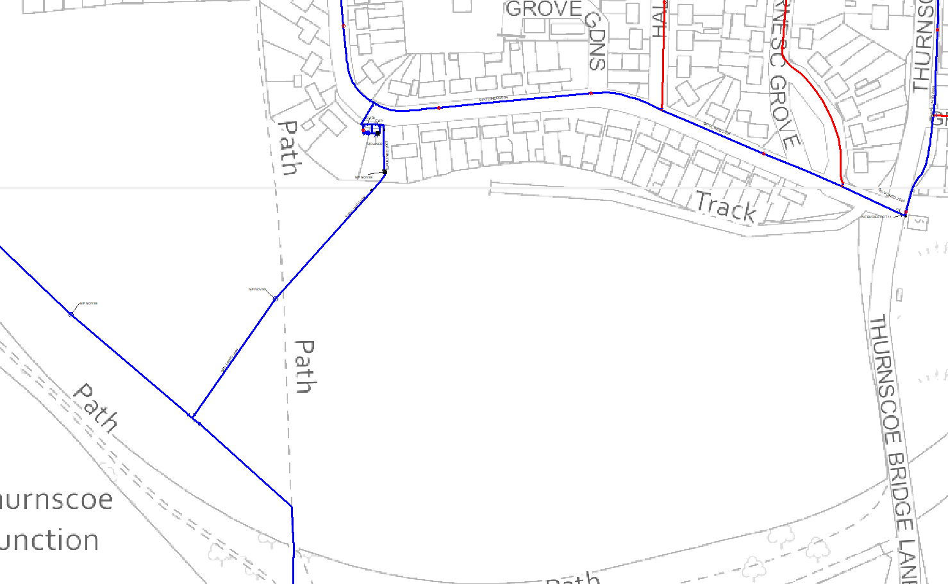

Slide 2
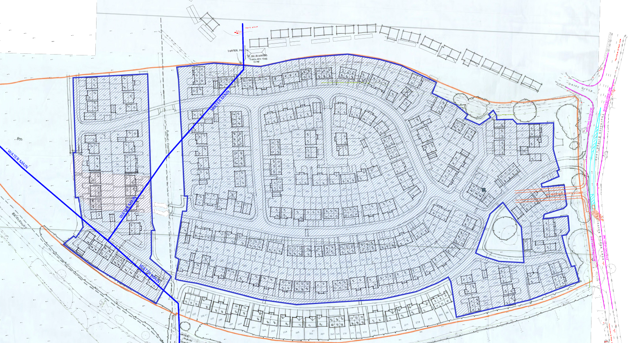
See detail A
X
X
See detail B
X
X
X
X
X
X
X
X
X
X
X
X
X
X
X
X
Divert approx 480metres of 180mm HPPE and abandon 6” CI
X
X
Divert approx. 110 metre of 225mm and abandon 9” CI
X
X
X
X
X
X
X
X
X
X

Slide 3
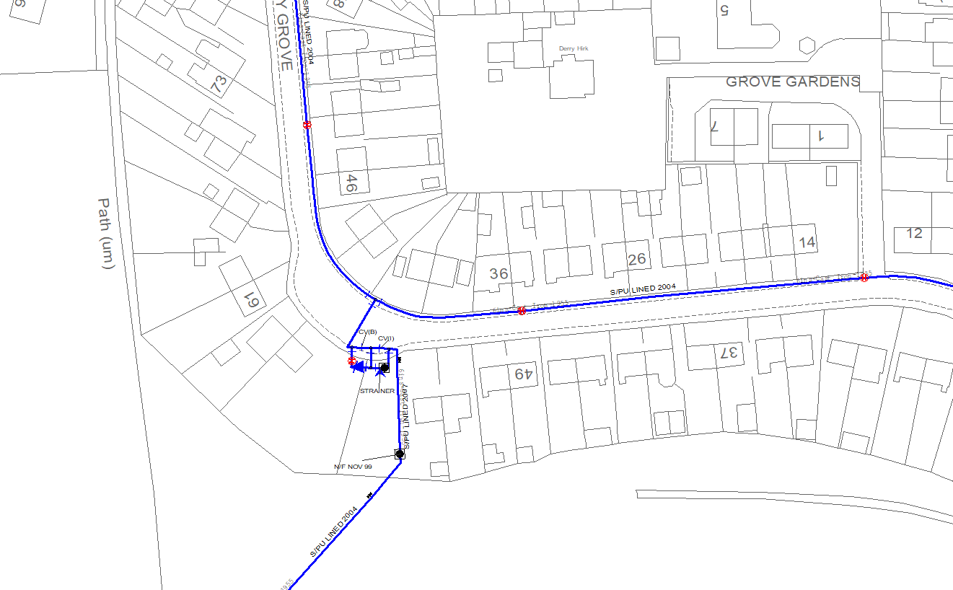
Detail A
Fit washout and abandon 9” along with meter /PRV and strainer arrangement
X
X
X
X
X
X
X
X
X
X

Slide 4
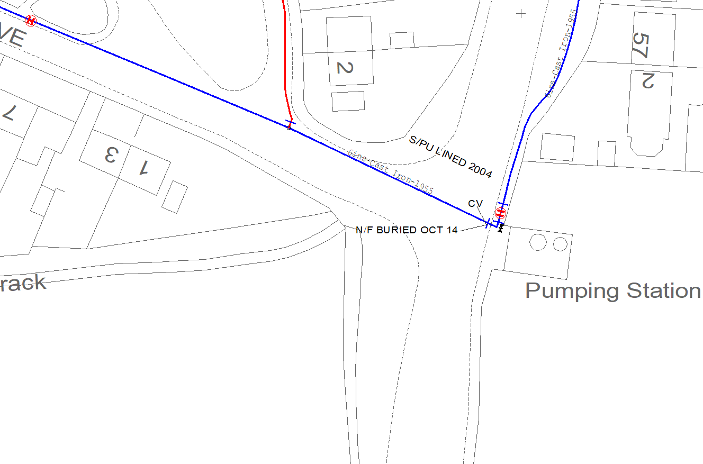
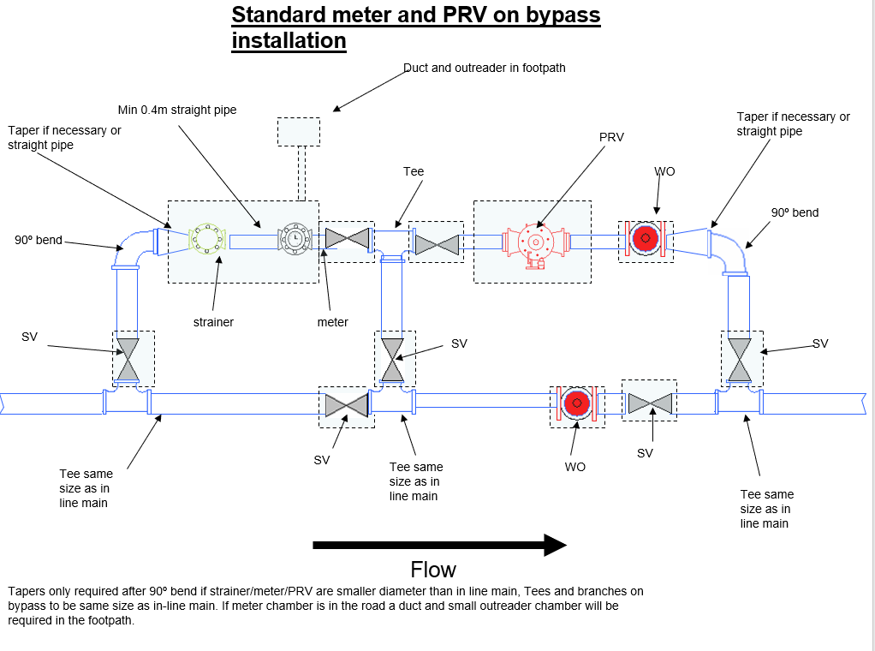
Detail B
Diverted 6” with new100mm strainer meter and bypass arrangement (standard design)

Slide 5
Summary
Divert approx. 110 metre of 225mm and abandon 9” CI
2x 9” UPC T’s
4x w/o
110 metres of 225mm mm HPPE
Divert approx. 480metres of 180mm HPPE and abandon 6” CI
9” to 6” T piece
1x 6” valve
1 x 6” UPC
2x w/o
Standard 100mm double bypass with 100mm Strainer Meter and 100mm PRV.
480 meters of 0f 180mm HPPE

